Slide 1



Generating Neighborhood of a String

Slide 2


Name | Roll No
Dhanush Krishna R | AM.EN.U4AIE20021
Dhruvjoti Swain | AM.EN.U4AIE20023
M Mahadev | AM.EN.U4AIE20045
Pranav Jayasankar Nair | AM.EN.U4AIE20056

Slide 3
TABLE OF CONTENTS
01 OBJECTIVE
02 INTRODUCTION
03 METHODS
04 RESULTS
05 CONCLUSION

Slide 4
01
Objective

Slide 5
In this project we deal with the problem of generating the neighborhood of a string.
Our aim is to find the the d-neighborhood of a string. Neighbors(Pattern, d) is the set of all k-mers whose Hamming distance from Pattern does not exceed d.
After doing this project we will have a efficient code which can be used to find the neighborhood of a string.

Slide 6
02
INTRODUCTION

Slide 7
DNA (Deoxyribonucleic acid) :
DNA is made up of units of biological building blocks called nucleotides. Deoxyribonucleic acid is a molecule composed of two polynucleotide chains that coil around each other to form a double helix carrying genetic instructions for the development, functioning, growth and reproduction of all known organisms and many viruses. DNA is a vitally important molecule for not only humans, but for most other organisms as well. DNA contains our hereditary material and our genes.
The information in DNA is stored as a code made up of four chemical bases: adenine (A), guanine (G), cytosine (C), and thymine (T). Human DNA consists of about 3 billion bases, and more than 99 percent of those bases are the same in all people. The order, or sequence, of these bases determines the information available for building and maintaining an organism, similar to the way in which letters of the alphabet appear in a certain order to form words and sentences.

Slide 8
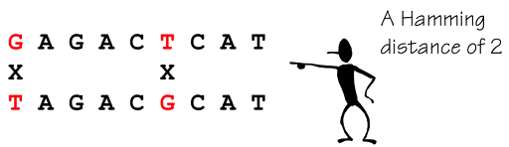
HAMMING DISTANCE:
Hamming distance is number of mismatches between two sequences of the same length. These sequences may be represented as character strings, binary strings, or arrays. In this project we are considering the DNA sequence. They are effectively used to detect and correct errors, Single-bit error correction using these Codes is effective on Data Stream Networks.
In this project it is determined by comparing two strands of DNA and counting how many nucleotides differ from their equivalent in the other string.

Slide 9
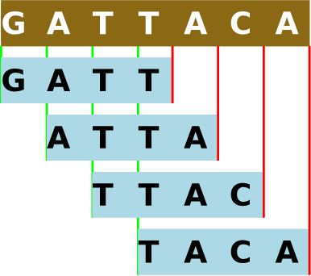
K-MERS :
k-mers are substrings of length k contained within a biological sequence. They are primarily used within the context of computational genomics and sequence analysis, in which k-mers are composed of nucleotides (i.e. A, T, G, and C).
To get all k-mers from a sequence we need to get the first k characters, then move just a single character for the start of the next k-mer and so on.

Slide 10
03
METHODS

Slide 11
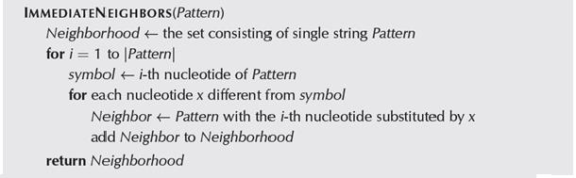
Immediate Neighbours
It gives all the strings with hamming distance 1.
Here we replace the I-th nucleotide with other nucleotide in a manner where it provides all those neighbor with their hamming distance 1.

Slide 12
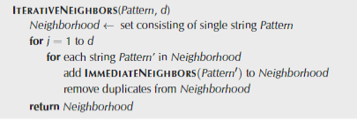
Iterative Method
Uses Immediate neighbours to generate neighbourhood of upto d mismatches with each iteration adding one missmatch

Slide 13
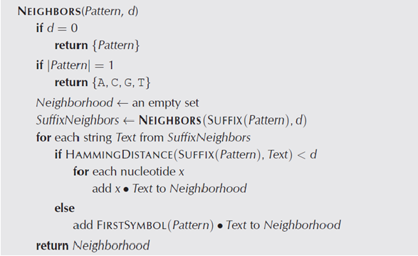
In the recursive method recurringly use the new pattern algorithm on the newly made patterns while lowering the hamming distance to generate more patterns.
Recursive Method
Algorithm:

Slide 14
04
RESULTS

Slide 15
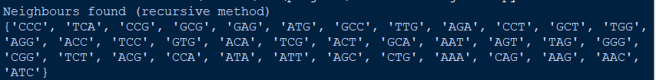

Input
String= ACG
d=2
Output

Slide 16
05
CONCLUSION

Slide 17
By this project we have got a clear idea about Hamming Distance , Finding neighbours ,K-mers, Dna. By looking at the results we can also conclude that a recursive approach here is faster than an Itterative Approach.
This algorithm can now be applied in other algorithms like Finding frequent words with mismatches, where it is used to lower the number of strings we need to consider while searching for frequent words.

